Slide 1
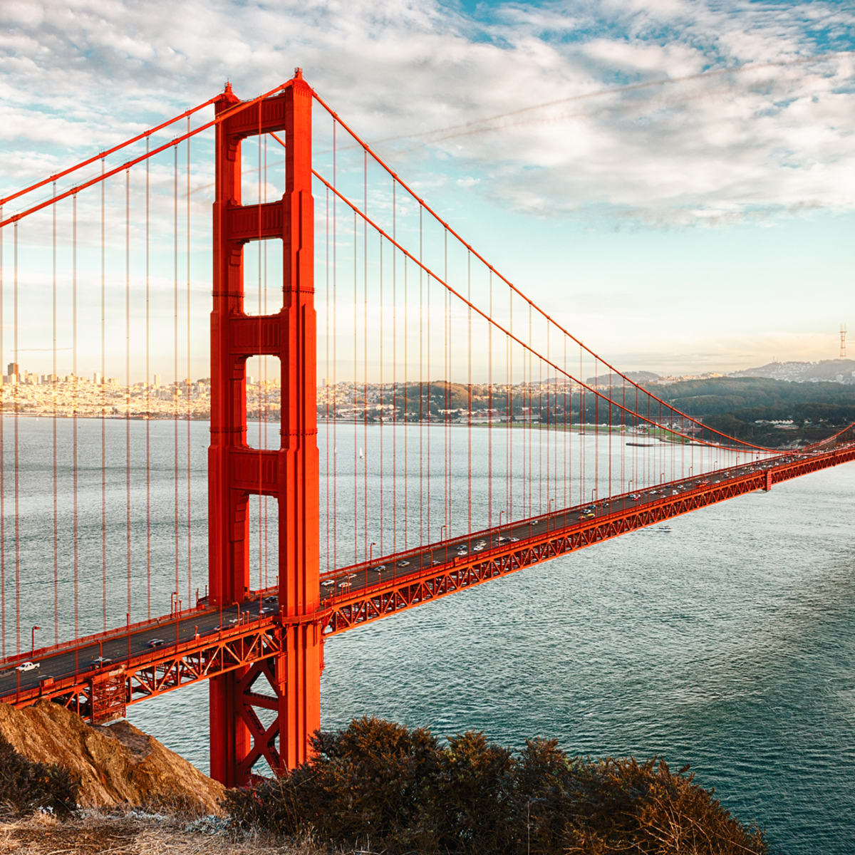
History Bridging Menu
You are about to start an exciting journey into the world of History, good luck!
Remember
Choose what modules you do and when, but work through them consistently. Different tasks will take you varying amounts of time, but on average you should aim to do one or two per week
All green tasks are core modules, they are compulsory and must be completed
The red hot chilli indicates that the task is more challenging than the others
Numbers eg (1) correspond to how you should evidence the module which can be found in the slides following the menu. They can be saved within this powerpoint or as separate documents clearly labelled with the subject

Slide 2
History Bridging Menu (Green modules are core (compulsory) modules , indicates the most challenging modules )
Reviews of your work should be saved in your Subject Lockers on Unifrog | Read | Watch | Listen | Visit (virtually or physically at a later date) | Do
 | A people's History of the USA by Howard Zinn (1) portrays a side of American history that can largely be seen as the exploitation and manipulation of the majority by rigged systems that hugely favour a small aggregate of elite rulers | The Iron lady (2011) (1) The Iron Lady is a 2011 biographical drama film based on the life and career of Margaret Thatcher (1925–2013), a British stateswoman and politician who was the first ever female and longest-serving Prime Minister of the United Kingdom since 1827. | Revolutions (1) American, English, French, Haitian, Mexican, Russian, and more: If it's a revolt, rebellion, or overthrow, | Visit the British Museum (7) Artefacts from across British history right up to the present day. Virtual tour available | MOOCs Search through the MOOCs using the filter ‘History’ and chose one that particularly interests you (5) https://www.mooc.org/
 | A Journey by Tony Blair (1) In 1997, Tony Blair won the biggest Labour victory in history to sweep the party to power and end eighteen years of Conservative government. | The Crown (1) Netflix takes us through the whole period covered in Year 12 from the point of view of the Monarchy. Brilliant TV as much as really quite useful for the course. | 15minutehistory.org has an episode on Reconstruction (episode 20)(1) | www.Milicenter.org - has all the presidents profiles including their policies. - easy to follow (1) | Create a table of all the American presidents from 1865-1975. (3)
 |  |  |  |  | Research 4 UK General Elections (4) 1951, 1964, 1979, 1997 Present your work by answering the following questions What were the appealing party policies? Did voting turnout play a part? Who did the policies of the winning party appeal to What was going on at the time to affect the result? How important were the media? Who were the leaders and what impact did they have? Whish of these elections changed Britain the most?
 | A History of Modern Britain – Andrew Marr (1) Read this before watching the TV series | Selma (2014). (1) based on the 1965 Selma to Montgomery voting rights marches led by James Bevel, Hosea Williams, Martin Luther King Jr., | Explaining History The Counterculture and the 1960s How the hippy movement developed https://courses.lumenlearning.com/boundless-ushistory/chapter/counterculture/ | University History Open Day (6) Visit a University Open Day a list of virtual days are on the link
 | Give me Liberty! By Eric Foner (1) Threaded through the chronological narrative is the theme of freedom in American history | Empire How Britain Made the Modern World. YouTube (1) Niall Ferguson showing how a gang of buccaneers and gold-diggers planted the seed of the biggest empire in all history | BBC Witness History The birth of Britain’s National Health Service - the NHS https://www.bbc.co.uk/programmes/p0053d39 (2). | Places where the Crown was filmed (1) www.visitengland.com
 | Margaret Thatcher – The Downing Street Years (1) Margaret Thatcher was the towering figure of late-twentieth-century | A History of Modern Britain Andrew Marr (1) Once you have read the book check out the TV series. confronts head-on the victory of shopping over politics. It tells the story of how the great political visions of New Jerusalem or a second Elizabethan Age, rival idealisms, came to be defeated by a culture of consumerism | Cspan lectures (1) 1890s Growing American Internationalsim | Explore the Unifrog History guide including the Geek Out sections (1)
 | Dominic Sandbrook – Never had it so good: The story of Britainn from Suez to the Beatles (1) takes a fresh look at the dramatic story of affluence and decline between 1956 and 1963

Slide 3
(1) - Book/Journal/Podcast/Film Review
Would you/would you not recommend it? Why?
Rating:
Review by: ___________________________________________
Title: _______________________________________________________
Author: ____________________________________________________
Review of (please circle)
Book Journal Podcast Film Documentary
What was it about?
What did you find particularly interesting/inspiring/shocking? Has this changed your opinion?
What would you like to learn more about?
How does it link to this subject and why is it important?
Save your answers as part of this powerpoint & copy the template as many times as you need

Slide 4
(2) BBC Witness History The birth of Britain’s National Health Service - the NHS Topical podcast takes you back to Britain in 1948 and the birth of its universal healthcare system.
What was the situation before the NHS was set up?
Why was it so controversial?
When did it start?
What areas of medicine did it cover?
Who was the Labour minister who started it?
What would the Conservatives have said about the creation of universal healthcare?

Slide 5
Create a table of the Presidents of the USA 1865-1975 (3)
Create a table of all the American presidents from 1913-1996.
Were they Republican or Democrat?
What event, action or policy are they most associated with or remembered for?
Write a brief summary of the event or action you choose.
I’ve done one for you to get you started.
President | Republican or Democrat
Woodrow Wilson 1913-1920 | Democrat | League of Nations After victory in WWI, Wilson was determined to ensure a lasting peace. The League of Nations was his idea – an international organisation which aimed to keep peace through collective security, disarmament and negotiation. After some notable successes and some early failures in the 1920s, the League ultimately proved incapable of preventing aggression by the Axis powers in the 1930s. The credibility of the organisation was weakened by the fact that, despite Wilson’s best efforts, the idea did not receive popular support in America and the United States never joined the League.

Slide 6
Research 4 elections 1951, 1970, 1979 and 1997. Present your work in the format above, answering the key questions and upload to your application. I have started 1997 for you.
1997 Election.
What were the appealing party policies:
Did voting turnout play a part?
Who did the policies appeal to and why?
1997- Labour landslide victory
Saw 13 years of a labour government
Lib Dems emerged as a significant third force at Westminster.
Tony Blair PM until 2007 when he was succeeded by Gordon Brown.
Conservatives troubled by on going divisions, poor leadership
Turnout: 71,4%
How was the losing party shown in a negative light?
What was the role of the media?
Party | No of seats | Increase/ loss of seats | % of popular vote
Labour | 418 | +145 | 43.2
Conservatives | 165 | -178 | 30.7
Liberal Democrats | 46 | +28 | 16.8
Who were the leaders and what impact did they have?
What was going on at the time that impacted on the results?
How effective was the election campaign of both sides?

Slide 7
MOOCs (5)
To evidence this you can
Save any notes you take
Take and save a screenshot of completed modules or the completed course

Slide 8
University History Open Day (6)
https://www.ucas.com/undergraduate/what-and-where-study/open-days-and-events/virtual-tours
What is the first year like on the BA History Programme?
What can I expect over the three years?
How important are different subject combinations for a History Degree?
Why study History and what do Universities have to offer?
What does your University look for in applicants?

Slide 9
(7) British Museum (they are running virtual tours)
Choose whether you would like to make a
Podcast
Informative flyer
Mini film
Report
Newspaper article

