Slide 1
Why study A Level Geography?
There has never been a better or more important time to study A level Geography. Dealing with vital issues such as climate change, migration, environmental degradation, social issues and natural hazards, A level Geography is one of the most relevant subjects you could choose to study.
Communication and Teamwork Skills
Research and analytical skills in IT
Fieldwork
Mixture of technical and social skills
Notes:
1. Physical Geography: is a branch of earth science, which looks at the natural elements of the world, including the atmosphere, land and oceans. Physical geographers study things like climate, soil, how the earth was formed and how it is changing over time.
2. Human Geography: is a social science that studies how humans interact with the planet and covers things like population growth, migration, how urban and rural settlements develop, how we work with animals and even how our economies are effected by the environment we live in
3. What Skills will I get from Studying Geography?
Geography will help you develop your communication and teamwork skills, as you’ll often work on group projects. You’ll also develop your research and analysis skills including in IT, lab and fieldwork, which means you will be able to collect and look for patterns in data.
Employers love the mix of technical and social skills people get from studying geography, which they see as very transferable, i.e. useful for a whole range of jobs.

Slide 2
What words can be associated with Geography?
https://youtu.be/iATfXV4lu4M
Notes:
1. Physical Geography: is a branch of earth science, which looks at the natural elements of the world, including the atmosphere, land and oceans. Physical geographers study things like climate, soil, how the earth was formed and how it is changing over time.
2. Human Geography: is a social science that studies how humans interact with the planet and covers things like population growth, migration, how urban and rural settlements develop, how we work with animals and even how our economies are effected by the environment we live in

Slide 3
What careers can you do with Geography?
According to the Royal Geographical Society, Geography graduates have some of the highest rates of graduate employment.
Environmental Lawyer
Conservationist
Surveying
Environmental Planning
Journalist
Meteorologist
Town and Transport Planning
Sustainable Analyst - Banking
Sustainable Consultancy
Landscape Architect
Law and Business
Research Organisations
Army
Police
Notes:
1. Physical Geography: is a branch of earth science, which looks at the natural elements of the world, including the atmosphere, land and oceans. Physical geographers study things like climate, soil, how the earth was formed and how it is changing over time.
2. Human Geography: is a social science that studies how humans interact with the planet and covers things like population growth, migration, how urban and rural settlements develop, how we work with animals and even how our economies are effected by the environment we live in

Slide 4
How am I assessed and graded?
A Level Geography Edexcel 9GEO
Paper 1: Physical 30% of the qualification 105 marks
Paper 2: Human 30% of the qualification 105 marks
Paper 3: Synoptic 20% of the qualification 70 marks
Paper 4: NEA 20% of the qualification 70 marks
Paper 1: Physical Geography Exam 2hrs 30 minutes 3 Sections 120 marks
Water and Carbon Cycle 4 mark Q x 1 6 mark Q x 2 20 mark Q x1 (Total 36)
Coastal systems 4 mark Q x 1 6 mark Q x 2 20 mark Q x1 (Total 36)
Hazards Multiple choice 1 mark x 4 6 mark Q X 1 9 Mark Q x2 20 mark x1 Total 48
Paper 2: Human Geography exam 2hrs 30 minutes 3 Sections 120 marks
Global systems and governance 4 mark Q x 1 6 mark Q x 2 20 mark Q x1 (Total 36)
Changing Places 4 mark Q x 1 6 mark Q x 2 20 mark Q x1 (Total 36)
Contemporary urban environments Multiple choice 1 mark x 4 6 mark Q X 1 9 Mark Q x2 20 mark x1 Total 48

Slide 5
How am I assessed and graded?
A Level Geography Edexcel 9GEO
Paper 1: Physical 30% of the qualification 105 marks
Paper 2: Human 30% of the qualification 105 marks
Paper 3: Synoptic 20% of the qualification 70 marks
Paper 4: NEA 20% of the qualification 70 marks
Paper 3: Synoptic Paper 2hrs 15 minutes Based on Synoptic Themes 70 marks
Paper 4: NEA 3000 – 4000 words 4 days compulsory fieldwork + your own fieldwork 70 marks Internally assessed and externally moderated Student defines their own question relating to the topic Student incorporates data collection as per their question Student creates and develops a report that focuses on the investigation analysis, evaluation of data, presentation of data findings and extended writing Students must show an evidence of a range of appropriate methodology (quantitative, qualitative, sampling methods) that is appropriate to the chosen location/study area

Slide 6
Monday, 04 July 2022
What is the power of superpowers?
Learning Objectives: To be able to understand how different types of powerful countries can be defined and characterised using a range of criteria
Do Now! What do you know about Geography?
Key Term + Definition
Superpower: A nation with the ability to project its influence anywhere in the world and be a dominant global force
Hyperpower: An unchallenged superpower that is dominant in all aspects of power (political, cultural etc.)
Blue Water Navy: One which can deploy into the open ocean. Smaller nations have green water navy that can only patrol littoral waters
Diplomacy: The negotiation and decision making that takes place between nations and international relations
Geo-strategic policies: Policies that attempt to meet the global and regional policy aims of a country by combining diplomacy and the movement on military assets
Key Concept
Hard vs Soft Power
Question | Answer 1 | Answer 2 | Answer 3 | Answer 4
1. Which sector of industry dominates emerging economies? | Primary | Secondary | Tertiary | Quaternary
2. Which of the following is an indication of an economically advanced economy, rather than an emerging economy? | Low life expectancy | High male/female inequalities | Literacy rates close to 100% | Poor access to technology
3. How is the economic core of a nation defined? | The core revenues and services | The area with the most people in a country | The area with the highest standard of living, and generating the most wealth | The urban areas that have the greatest links and technology infrastructure
The receiving country is forced to buy goods and services from the donor country
Geochallenge: Many emerging economies rely on aid from other nations and charities. Sometimes this aid is tied to trade agreements. What is an advantage of tied aid to the donor country?

Slide 7
Where are we on our learning journey?
Superpowers
7.1 | The power of superpowers
7.2 | Changing patterns and polarity
7.3 | Emerging powers
8.1 | The global economic system
8.2 | International decision-making
8.3 | Global environmental concerns
9.1 | Contested geography
9.2 | Developing countries: opportunities and threats
9.3 | Uncertainty for existing superpowers

Slide 8
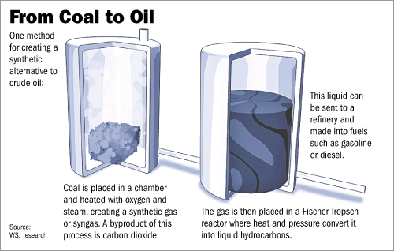
What is hyperpower?
Learning Objectives: To be able to understand how different types of powerful countries can be defined and characterised using a range of criteria
A useful definition of a superpower is a nation that can ‘conduct a global strategy including the possibility of destroying the world; to command vast economic potential and influence; and to present a universal ideology (Professor Paul Dukes)
In some cases a superpower is referred to as a Hyperpower
Emerging superpowers are those nations whose economic, military and political influence is already large and growing
Regional power are smaller – they influence other countries at a continental scale
South Africa in Africa
Despite the serve recession in 1991, South Africa’s economy ha remained buoyant in comparison to is neighbouring states (with the exception of Botswana). In 1989, South Africa’s accounted for more than 80% of the GDP of the countries of the 10 countries in the southern region.
It does not have the oil reserves but it has the technology to covert coal into oil

Slide 9
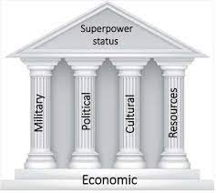
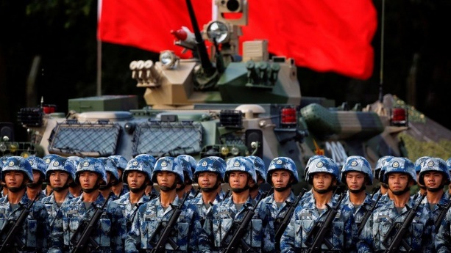
What are the pillars of superpowers status?
Learning Objectives: To be able to understand how different types of powerful countries can be defined and characterised using a range of criteria
Task 1: Stick in the Pillars of Power in your book and annotate around the diagram, explaining how each factor contributes to superpower status
Political Power: The ability to influence others through diplomacy to ‘get your way’ is important and is exercised through international organisations such as the UN and World Trade Organisation
Cultural Power: Includes how appealing a nations way of life, values and ideology are to others, and is often exercised through film, the arts and food
Geochallenge: Explain how blue water navy can contribute to superpower status
Military Power: This is used in two ways
The threat of military action is bargaining chip
Military force can be used to achieve geopolitical goals
Some forms of military power such as blue water navy, drone and missiles can be deployed globally and reach distant places
Resources: Can be in the form of physical resources (fossil fuels, minerals, land) but also human resources. The latter includes the level of education and skills in a nation, but also the sheer numbers of people (‘demographic weight’).
Economic Power: This represents the ‘base’ of the temple and is a prerequisite of power. A large and powerful economy gives nations the wealth to build and maintain a powerful military, exploit natural resources and develop communities through education

Slide 10
What is hard and soft power?
Learning Objectives: To be able to understand how different types of powerful countries can be defined and characterised using a range of criteria

Slide 11
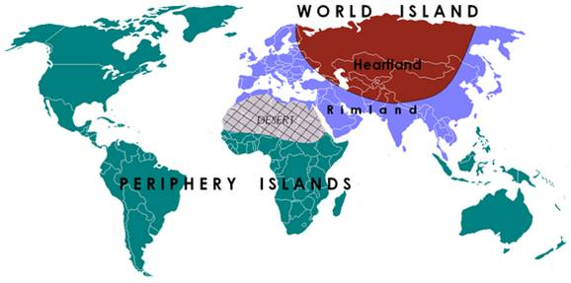
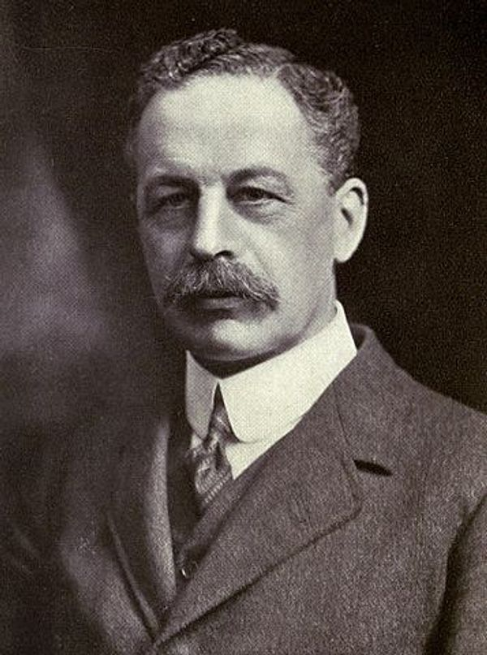
What is hard and soft power?
Learning Objectives: To be able to understand how different types of powerful countries can be defined and characterised using a range of criteria
Very broadly, it is the case that hard power has become less important that soft power over time. During the colonial and imperial era, from 1600 to 1950, powerful countries conquered and controlled territory by military force. Armed forces were often positioned across the world in a way akin to a global game of chess. This approach was influenced by early geo-strategic thinking.
In 1904 Halford Mackinder, a British Geographer, identified a region if Eurasia he named the 'Heartland' (Russia to China and from the Himalayas to the Arctic). He argued it was a geo-strategic location because it included a large proportion of the world's physical and human resources.
Later, Halford Mackinder theories were influential and used in:
1. WW1 to limit the ability of Germans to expand the land area it controlled
2. Post-WW2 NATO allies attempts to contain Soviet Union expanding into western and southern Europe
3. The American 'Trump Doctrine' to contain the spread from the Soviet Union to China

